Slide 1
Blue Mountain Resort
ADD NAMES

Slide 2
How can blue mountain arrive at optimum pricing for their resort based the services they offer by studying competitor pricing data?
Context to the problem
Operating Cost went up to $1.4 M.
Because a new chair lift was installed
Instead of increasing/decreasing the price Blue Mountain Resort wanted to increase the value of their ticket and increase the amount of purchases of tickets.
Criteria for Success
Find a way to increase revenue to outway the spending cost

Slide 3
How can blue mountain arrive at optimum pricing for their resort based the services they offer by studying competitor pricing data?
Scope/Constraints of Solutions
Scope to solution would be to create an effectictive machine learning models to find a way to utilize what is there to increase profit margins
Constraints would be the underutilized ways might cost more money to gain traction to.
StakeHolders:
Blue Mountain Executives
Technicals(Colleagues and Managers)
Non- Technicals(Others who helped who did not have a technical background)
Key Data Scources
CSV file with data overview of the 330 resorts in the United States.

Slide 4
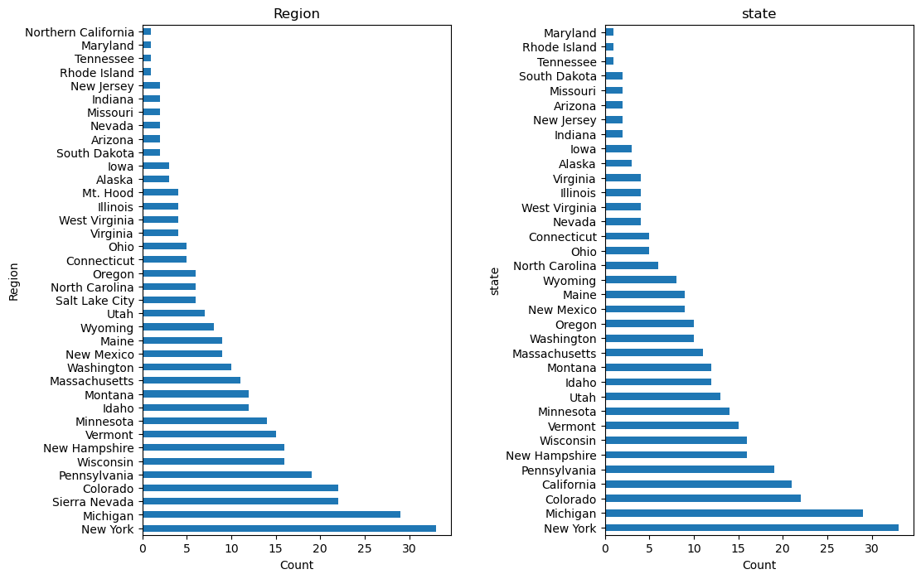
Recommendation and key findings
State of Montana placed 13th for highest count for Region and State.
This helped us decide it was better to compare Blue Mountain resort with other resorts in Montana to have a better market share understanding.

Slide 5
Train/Test
Train/Test split was 70/30
Tested the Train mean with a Dummy regression mean to see the similarity.
Both came out with an answer of “63.81108808”
MAE and MSE were also calculated.
MAE told us if guessed ticket prices were based on average known values
MSE helped compare the actual values to the predicted values

Slide 6
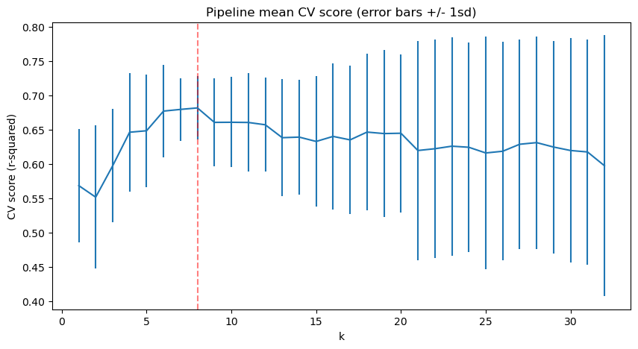
Cross Validation and Analysis
By using Sklearn we repeatedly created a pipeline using the SelectKbest to find K.
Throughout the cross validation it indicated that the best value for K was 8.
This was because there was an increase until 8 and a decrease after 8.

Slide 7
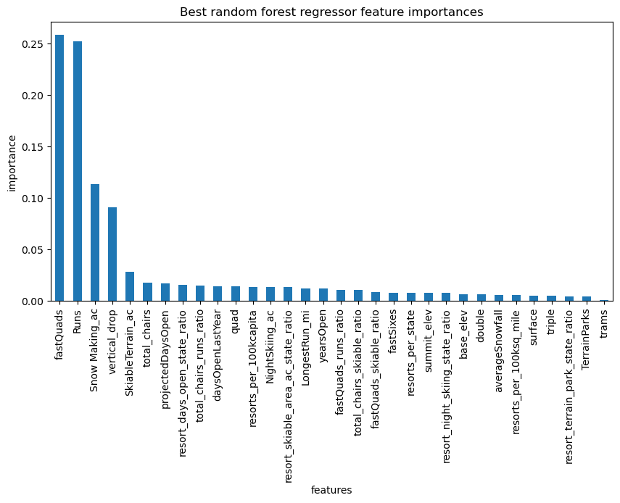
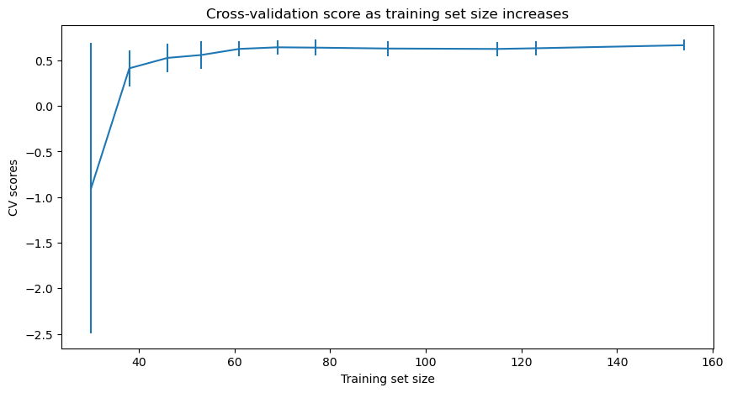
Random Forest vs Linear Model
Below are graphs from using two methods (Random Forest and Linear Model)
It concluded with the Randon Forest had a lower Cross-Validation error of $1

Slide 8
Summary and conclusion
After constructing some scenarios:
Closing up to 10 of the underutilized runs
To add a run, increase vertical drop 150 ft, and install an additional chair lift
Same as b but also 2 acres of snow making
Increase longest run by .2 miles and adding 4 acres of snow coverage its snow making capability.
The best solution was to was to follow scenario c because you would have to and add $1.99 to the current price to make it $81.99 to average a revenue of $3,474,628 and would utilize what the resort has to offer and expand it while still profiting.

